Slide 1
Workplace Giving PRIMER for ARNOVA Bill huddleston cfcfundraising.com
Bill Huddleston, CFC Fundraising.com

Slide 2
CFC & Workplace Giving in the 21st Century Modules
Introduction
Nuts & Bolts - General
7 CFC Fundraising Secrets
Campaign Events
Nuts & Bolts – Donors

Slide 3
Introduction
Workplace giving is the only type of non-profit fundraising that is subsidized, low-risk, and high leverage.

Slide 4
Introduction
What is the Combined Federal Campaign (CFC)?

Slide 5
Nuts & Bolts: Eligibility
Non-Profit Eligibility
Be a 501(c)3 registered with the IRS.
Have an office open for 15 hours a week with a dedicated phone line.
Provide a complete IRS 990 to the CFC
Charities with revenues > $250,000 must have audited financials.
Must use accrual method of accounting.

Slide 6
Nuts & Bolts: Types of Charities
National
Services provided in 15 or more states
International
Services provided in one or more countries
Local
More than 220 Regional CFCs

Slide 7
Nuts & Bolts: Federations
Federations are groups of charities with something in common, e.g. :
Community Health Charities
America’s Charities
EarthShare
Children’s Charities of America
Global Impact
United Way charities
National & International Federations
Local Federations

Slide 8
Nuts & Bolts: CFC Organization
Office of Personnel Management (opm.gov)
Overall regulator, writes rules, approves national and international charities.
Local Federal Coordinating Committee (LFCC)
Board of Directors, 100% Federal employees
PCFO (Principal Combined Fund Organization)
Contractor to the government
Runs the CFC campaign and distributes funds

Slide 9
Nuts & Bolts: CFC Pros and Cons
PROs
CONs
CFC funds are unrestricted, reliable & predictable.
Less red-tape than grants.
Workplace Giving is “low money down,” subsidized fundraising:
Solicitations by employees.
Campaign support, rooms at agency.
Lag time between solicitation period and disbursement period.
Lag time between donor making pledge and non-profit getting list of donors.
Anonymous Donors make it harder to communicate.

Slide 10
Overview
CFCs
National Capital Area (largest CFC in the country), Potomac, Chesapeake Bay, St. Mary’s
Department of Defense, U.S. Postal Service, Civilian Agencies
220 Regional CFCs in the USA
In terms of actual giving, if the CFC were a foundation, it would be the 10th largest foundation in America.
State & Local Workplace Giving Campaigns
Many states have public employee workplace giving campaigns, e.g. State Campaigns California, Virginia, etc.
Private Sector
Lockheed Martin, Washington Gas, AARP, ExxonMobil, SAIC, CSC, largest companies in your region.
Notes:
CFC notes:
In 2010 our members were offered nearly 100 invites for CFCNCA events. Includes invites made to all America’s Charities’ federations
Over $67 million was raised in the CFCNCA last year
Private Sector notes:
Generated over 120 separate opportunities for charities to be seen by employees. There were over 30 events with multiple slots for charities.
Lockheed has the most events across MD, VA and DC.
About $10 million was raised from fiscal campaigns in the DC metro area in 2010.

Slide 11
Overview Timeline for 2011 Campaign Events
November 2010 through August 2011 - CFC non-profits apply and prepare for the solicitation season.
August 2011 through December 2011- Most campaign events are planned and occur in this timeframe.
CFC campaign dates are September 1st - December 15th
Private campaigns generally follow the CFC’s timeframe
October is the busiest month!

Slide 12
CFC & Workplace Giving in the 21st Century Modules
Introduction
Nuts & Bolts - General
7 CFC Fundraising Secrets
Campaign Events
Nuts & Bolts – Donors

Slide 13
Nuts & Bolts: Donor Perspective
Most Donor Friendly
With one pledge card and one transaction:
● Can donate to multiple charities.
● Gives money to the non-profit before it ever hits their checkbook.
● Feels secure—their personal information is never on the Web; government payroll systems are secure.

Slide 14
Nuts & Bolts: Donor Perspective
CFC is a Mandatory, Completely Voluntary Program
All US Federal Agencies conduct a CFC campaign
Agency Head is Chair of CFC campaign
CFC Volunteers are recruited
Training & Face to Face Events are Planned
CFC Catalog of Caring
Kickoff Events (Video)
Charity Fair

Slide 15
National Capital Area CFC 2011 Catalog: Martha’s Table
(202)328-6608 www.marthastable.org
EIN #521186071
Fights poverty in the short and long term through emergency food, clothing assistance, and educational programming for low-income children, families and individuals.
(25 word description written by the charity).
10.9% O,P,W (Overhead rate, Non-profit categories)

Slide 16
CFC & Workplace Giving in the 21st Century Modules
Introduction
Nuts & Bolts - General
7 CFC Fundraising Secrets
Campaign Events
Nuts & Bolts – Donors

Slide 17
Campaign Events 2011

Slide 18
Campaign Events 2011 Types of events
Types of events
Campaign kick offs
Charity fair
Speaking engagements
Testimonials
Bake sales/Chili Cook-offs
Competitions

Slide 19
Other Avenues of Communication
Social Media
Internet
Video

Slide 20
CFC & Workplace Giving in the 21st Century Modules
Introduction
Nuts & Bolts - General
7 CFC Fundraising Secrets
Campaign Events
Nuts & Bolts – Donors

Slide 21
7 Keys to CFC Success
Work from your strengths
Learn the CFC game– the rules and how to play
Use all 12 months of the year
Understand why the CFC is the most donor friendly means of contributing
Learn how to generate other resources from CFC
Use the Tools of the 21st Century
Say Thank You Early and Often

Slide 22
Keys to Success: Exercise #1 –
List 3 strengths of your non-profit:
________________________
________________________
________________________

Slide 23
Keys to Success: Exercise #1 – Sample
List 3 strengths of your non-profit:
We’re like “Cheers” – Everyone knows our name and mission.
CEO is a talented and sought after keynote speaker, she’s a tremendous asset to us.
Large group of dedicated volunteers, staff is energetic but inexperienced.

Slide 24
CFC FUNDRAISING SECRETS
To improve your CFC results.

Slide 25
CFC Fundraising Secret #1
Don’t run a STEALTH campaign!
Tell everyone you’re in the CFC!
Is the CFC logo and your ID # on your homepage?
Does your e-mail signature include your workplace giving ID numbers?
Work hard in the CFC solicitation period in the fall; but activities can take place at any time.
Use all 12 months of the year!

Slide 26
CFC Fundraising Secret #2
Thank ALL your supporters, including:
(1) Known CFC Donors;
(2) Anonymous CFC Donors (more than 60% of all donors);
(3) CFC Volunteers
Do print materials (e.g. annual reports, newsletters, etc.) include thanks to your workplace giving donors, including the anonymous donors?
Do you thank workplace giving donors and volunteers at recognition events?

Slide 27
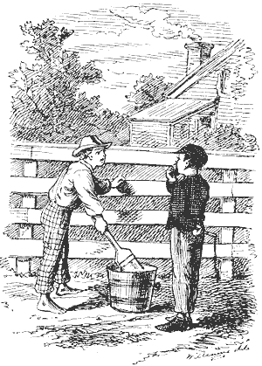
CFC Fundraising Secret #3
Use the leverage of CFC!
Your non-profit’s 25 word description is distributed to every Federal employee in that region.
CFC leverage = the cost to mail a postcard to that group
For national and international charities, one application gets you into all 220 CFCs worldwide.
1,500 to 3,000 charities in one catalog, compare that to direct mail from 3000 charities.

Slide 28
Exercise #2: Fish where the fish are
Geography/ proximity may help. Find out if large federal installations are near you. For example:
Defense Department installations:
(Navy, Army, Air Force, + DOD Civilian Agencies)
Veterans Affairs installations:
(Hospitals, Treatment Centers, etc.)
U.S. Postal Service: Post offices, Regional processing centers, etc.
List installations near you:____________________
___________________________________________

Slide 29
CFC Fundraising Secret #4:
Think Donors Not Dollars!
Relationships are key, you have supporters for whom the CFC is the most donor friendly way for them to give.
Make it easy for your Federal supporters to support you.
Growth comes a lot easier when you think of them as people, not money machines.

Slide 30
Exercise #3: Federal connections?
Determine how many of your current supporters have a Federal “connection”, meaning: current employee, retiree, friend, neighbor, spouse, parent, child, client, visitor, , patrons, students, board members, etc.?
_____________________________________________
_____________________________________________
_____________________________________________

Slide 31
CFC Fundraising Secret #5:
Teach Your Donors how you want them to give!
Do you know the 3 magic words that will triple the size of your CFC gift?

Slide 32
CFC Fundraising Secret #5:
Thank you for your generous gift
through payroll deduction
to the ABC CFC charity.
Why?
The same person who will give you a $100 check will sign up for a $12 per paycheck donation (26 *12) = $312, more than triple the amount of a one-time gift.

Slide 33
CFC Fundraising Secret #6:
Workplace giving provides the ideal “practice field” for non-profit leadership.
Public Speaking: in CFC campaigns you get to give your “elevator speech” hundreds of times.
Listening skills
Management skills

Slide 34
CFC Fundraising Secret #7
The CFC Logo is a tool worth millions, provided free to CFC charities (and only charities in the CFC can use it). Don’t ignore a free million dollar tool, use it!

Slide 35
Use All Tools Available
How do you get attention if:
Your brand is one of the most recognized in the world?
You have resources for all types of communication.
CFC generates $7 Million annually for you?
Do you use only 20th and 21st Century Tools?

Slide 36
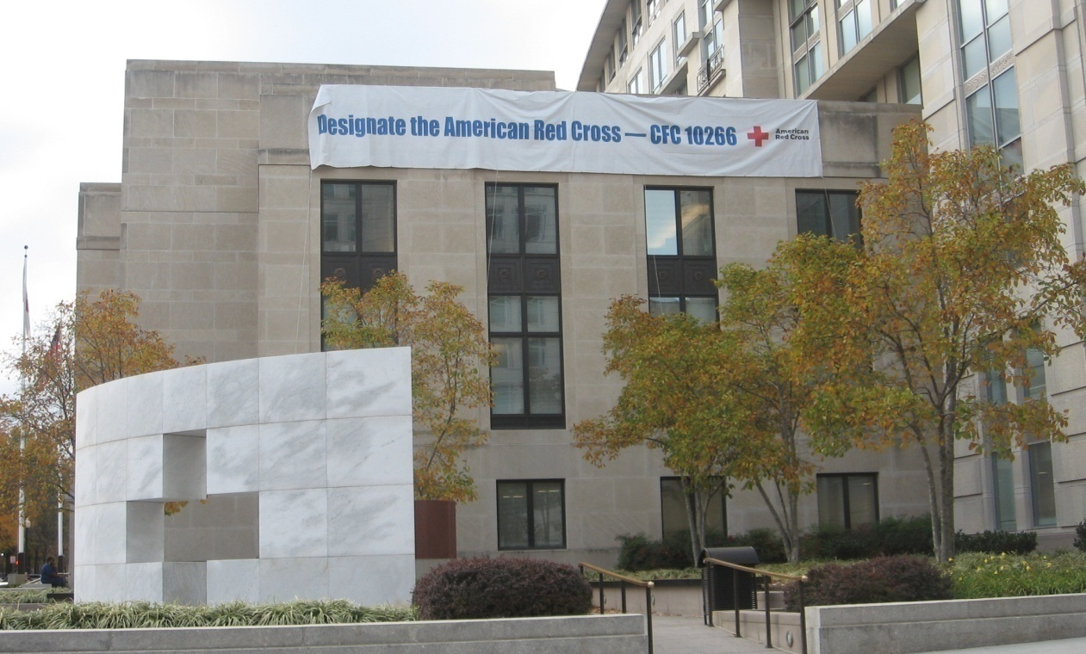
Successful CFC Fundraising cfcfundraising.com Bill Huddleston
Hang a Sign From Your Rooftop!
Just because it’s the 21st Century,
Don’t Forget that 18th Century Tools Still Work!

Slide 37
Recap: 7 Keys to CFC Success
Work from your strengths
Learn the CFC game– the rules and how to play
Use all 12 months of the year
Understand why the CFC is the most donor friendly means of contributing
Learn how to generate other resources from CFC
Use the Tools of the 21st Century
Say Thank You Early and Often

Slide 38
Questions & Answers

Slide 39
CONTACT INFO: BillHuddleston@Verizon.net (703) 560-1825

Slide 40
CFC Fundraising Secrets The Insider’s Guide to the Combined Federal Campaign THANK YOU!
BillHuddleston1@gmail.com 703-560-1825
CFCfundraising.com

Slide 41
APPENDIX
Fundraising Pyramid & the Fundraising Tetrahedron
Comparison of types of non-profit fundraising
“Three Cs” Exercise before deciding on a new project or program.

Slide 42
Fundraising Pyramid 21st Century
Mega Gifts
Major Donors
Annual Fund, Workplace giving, Internet, Text Messages, Cause Marketing, Memberships, Products

Slide 43
Fundraising Tetrahedron™ (3 sided pyramid- your non-profit’s mission is the base)
CFC
Annual
Fund
Gifts
Money:
Unrestricted &
Restricted,
Grants, One-time, multi-year
Lifetime gifts
Time:
Yours, Staff (Paid & Volunteer),
Board Members,
FR Volunteers
Other Resources:
Brand, Buildings,
Space, Media, etc.

Slide 44
Fundraising Comparison – 1 of 2
Activity | Direct Fundraising (Annual Fund/ Major Donor) | Grant Seeking (Foundation/Govt.) | Workplace Giving (CFC Model)
Who Funds? | Donor | Donor/Taxpayer | Donor
Whose Checking Account Pays the Expenses? | Non-profit’s | Non-profit’s | Donor’s
Type of Campaign | Variable Cost (e.g. additional solicitations made, costs increase | Time & Salary costs increase as more grants are applied for. | Fixed Cost Campaign – 100% of Federal workforce is solicited.

Slide 45
Fundraising Comparison – 2 of 2
Activity | Direct Fundraising (Annual Fund/ Major Donor) | Grant Seeking (Foundation/Govt.) | Workplace Giving (CFC Model)
Opportunities for face to face communication? | Annual Fund – minimal Major Donor - Yes | Minimal at early stages | Kick-offs, charity fairs, non-profit open houses,
Average Length of Funding | Varies for annual fund. Extensive for major donors. | 1-3 years (more than 5 is rare) | CFC donors often give for 10 or more years
Amount of Red Tape | Not applicable | Extensive, especially after grant is awarded. | List of activities for application. NO RED TAPE ON BACK END!

Slide 46
Three “C”s of Deciding Upon any one of the Portfolio Approaches
Capabilities
Notes:
Who will be responsible for the day-to-day accomplishment of the tasks?
What skill sets are needed?
Does current staff (paid or volunteer) have the needed capabilities?
________________________
_________________________
_________________________

Slide 47
Three “C”s of Deciding Upon any one of the Portfolio Approaches
Capacity
Notes:
Even if your staff have the capabilities needed, do they have the capacity at present to handle a new project/program?
Or, in other words are their plates already too full?
_______________________
_______________________
______________________
______________________

Slide 48
Three “C”s of Deciding Upon any one of the Portfolio Approaches
Commitment
Notes
Is the Board supportive of the new planned program/fundraising method?
How much money have they committed to it? (If the answer to this is zero, or unrealistic, the answer to #1 is no!)
Does ED have the time?
______________________
______________________
_______________________ _______________________
____________________

